Slide 1
Chat Application in Java (Talk Wave)
Guided By: Ms. Zaibunnisa Malik

Slide 2
Group Members
Abdurrahman Qureshi 210451
Oaish Qazi 210455
Hussain Shaikh 220486

Slide 3
What is a Chat Application?
A chat application, also known as a messaging app or instant messaging application, is a software program or mobile application that allows users to exchange text messages in real-time over the internet
Popular examples of chat applications include WhatsApp, Facebook Messenger, Slack, Microsoft Teams, Telegram, and many more. These applications serve a wide range of purposes, from personal communication to business collaboration and team messaging, making them an integral part of modern digital communication.

Slide 4
How does a Chat Application work in a Network?
A chat application in a network, like any networked application, relies on a client-server model.
In this model, there are two main components: the chat server and the chat clients.
Steps:
Server Setup
Listen for Connections
User Authentication
Message Routing
Real-Time Communication

Slide 5
What is a Servlet?
A servlet is a Java program that runs on a web server.
Servlets are written in Java and compiled into bytecode. The bytecode is then deployed to a web server, such as Tomcat or Jetty.
When a user requests a servlet, the web server loads the servlet bytecode and creates a new instance of the servlet. The servlet then handles the request and generates a response.

Slide 6
Life Cycle of a Servlet
Servlets have a well-defined lifecycle, including methods like init(), service(), and destroy(). These methods are called by the servlet container (e.g., Apache Tomcat) at various stages of a servlet's existence.
init(): This method is called when the servlet is first loaded by the container. It's used for one-time initialization tasks.
service(): This method is called to handle client requests. It's responsible for processing the request and generating a response.
destroy(): This method is called when the servlet is being taken out of service. It's used for cleanup tasks.

Slide 7
What is a WebSocket?
WebSocket is supported by many programming languages, web frameworks, and browsers. To use WebSocket in web applications, you can use JavaScript to create WebSocket connections in the browser and set up WebSocket servers on the server-side using languages like Python, Node.js, Java, and more.
This bidirectional communication protocol has become an integral part of modern web development for real-time and interactive features.

Slide 8
Properties Of WebSocket
Full-Duplex Communication: This makes it suitable for real-time applications where both the client and server need to exchange data without waiting for a request.
Low Latency: WebSocket reduces the latency compared to polling or long polling techniques, where the client repeatedly requests updates. With WebSocket, the server can push data to the client as soon as it's available.
Bi-directional: WebSocket allows data to be sent from both the client and server at any time, making it suitable for interactive applications where users may send and receive data concurrently

Slide 9
The next few Slides will show the Outputs:

Slide 10
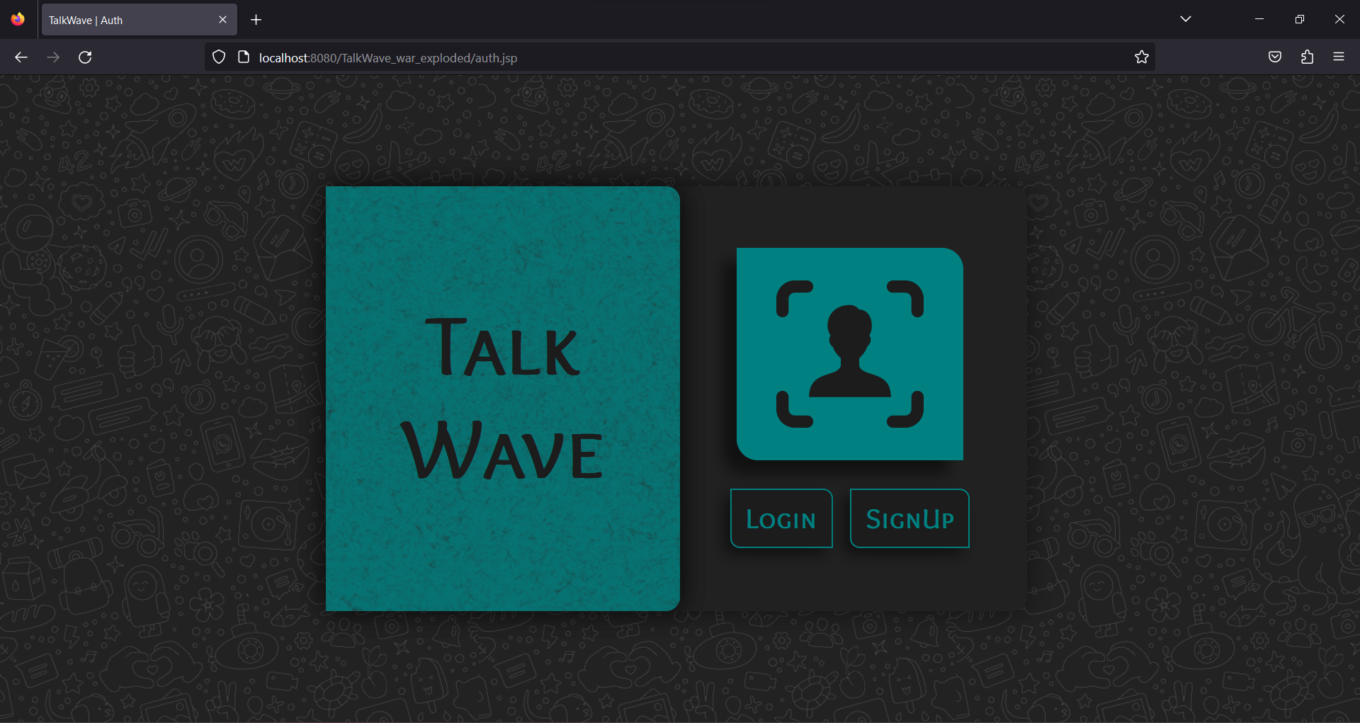
OUTPUTS

Slide 11
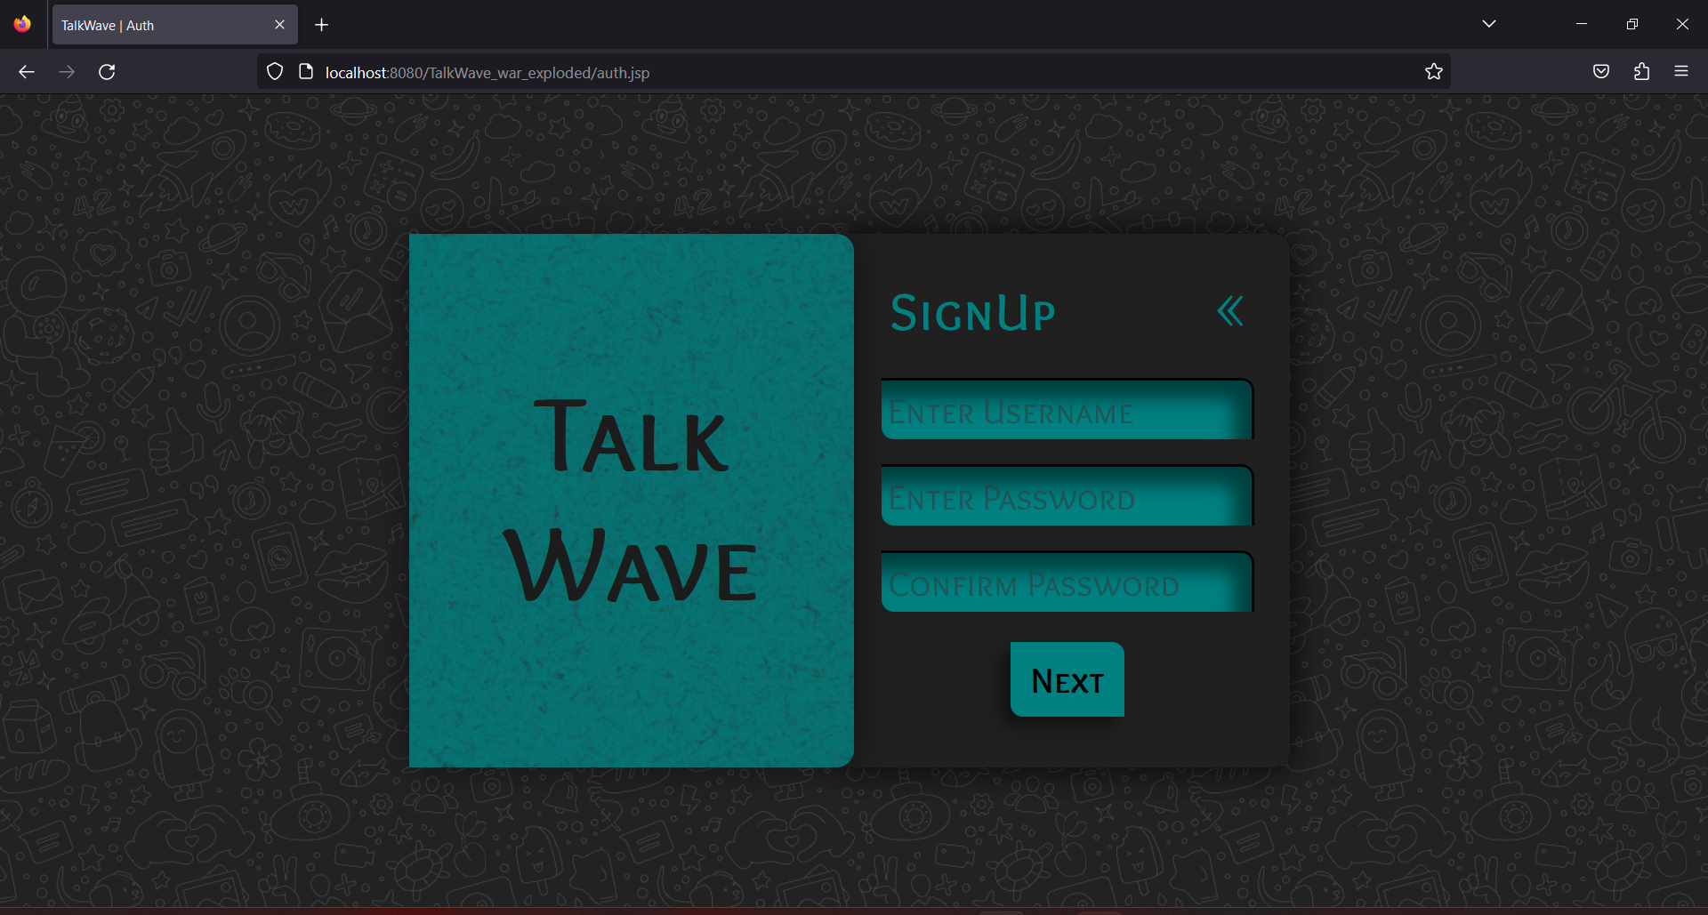

Slide 12
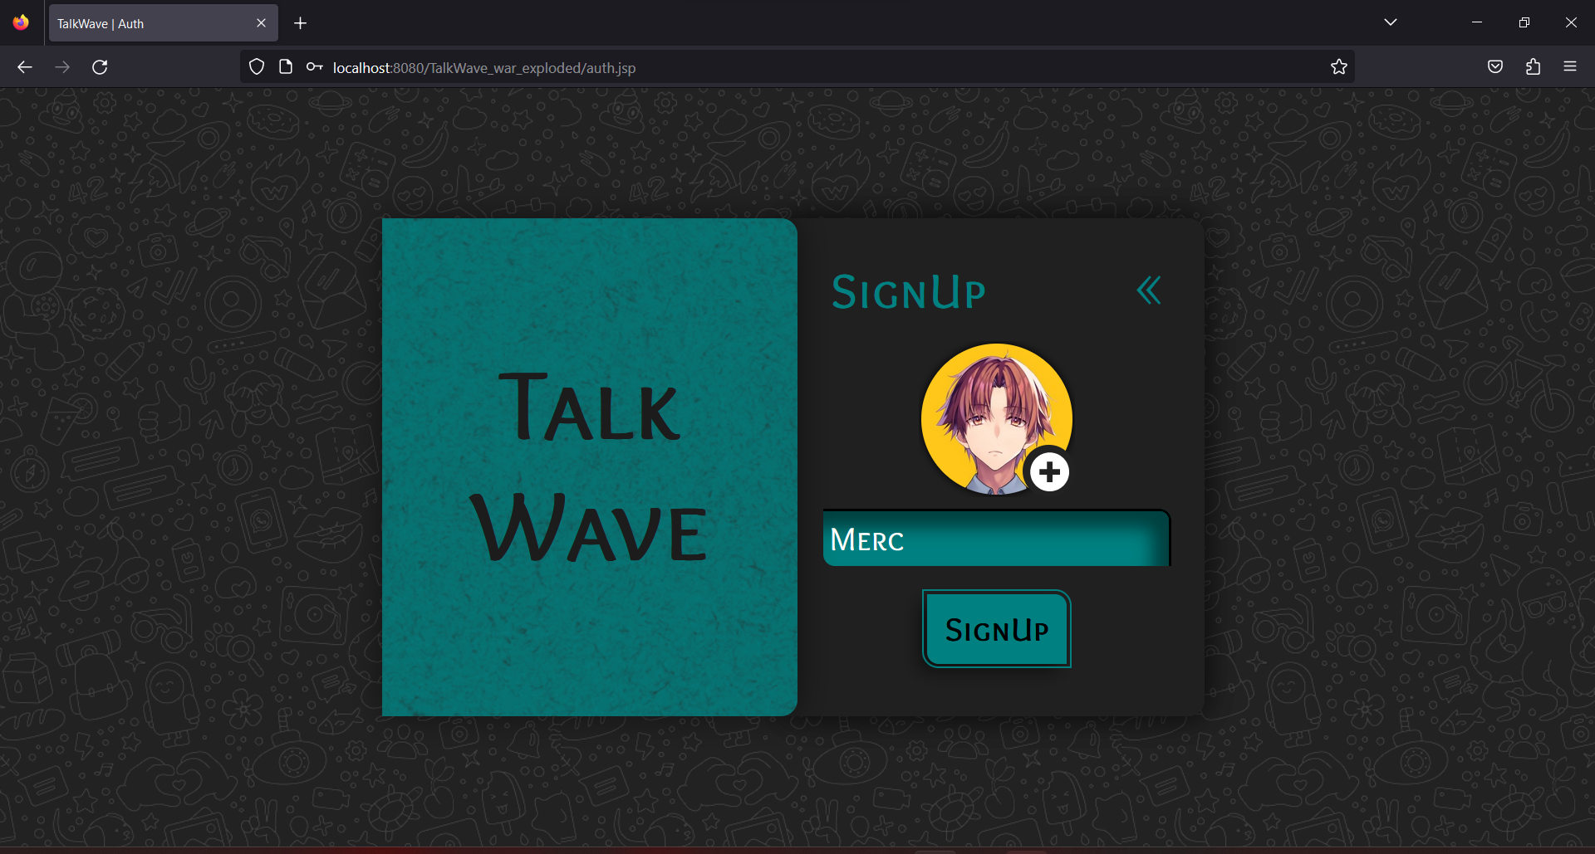

Slide 13
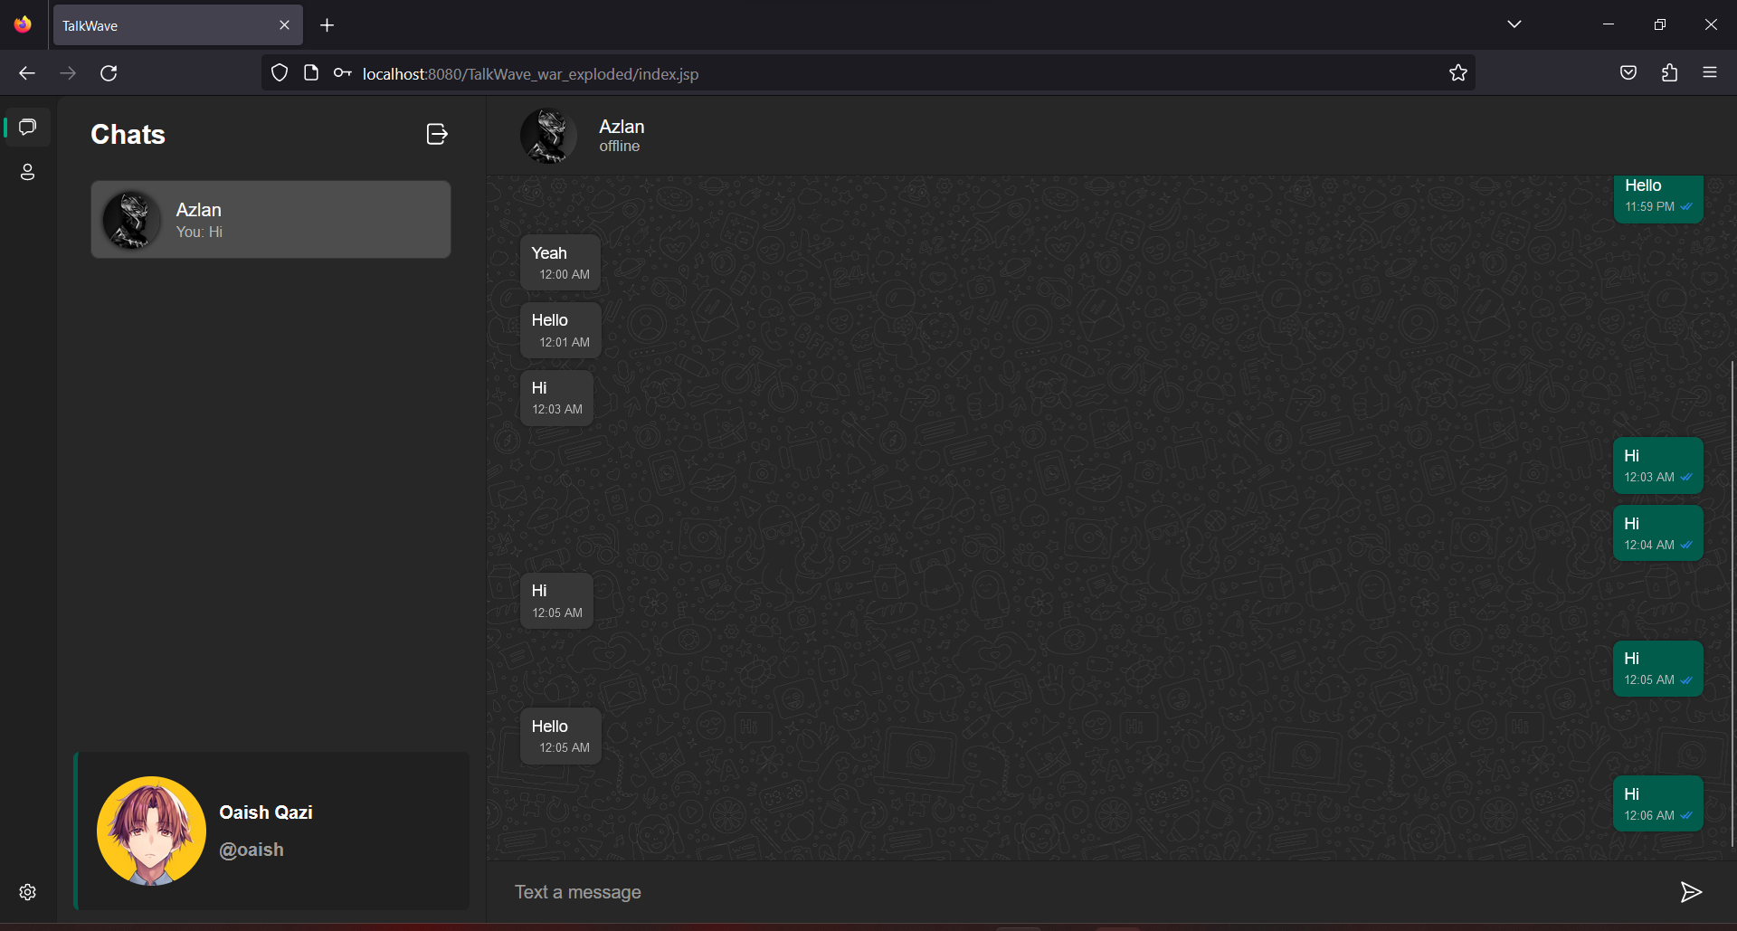

Slide 14
